Slide 1
Energy

Slide 2
Bell Work
What comes to mind when you hear the word energy?
What is Energy?
What is related to energy?
What causes or stops energy?

Slide 3
Energy
When an object has energy, it can make things happen. So, ENERGY is the ability to cause change.
Use these ideas to come up with your own definition for energy with your partner.

Slide 4
Energy of motion
Kinetic energy: energy an object has due to its motion.
Is it possible for something to have more or less kinetic energy? Discuss with your partner

Slide 5
The correct answer is YES!!
Kinetic energy depends on two things
Speed :the faster the object the more kinetic energy it has
Mass: the heavier the object the more kinetic energy it has

Slide 6
Energy of motion
Kinetic energy
Changes due to speed
Changes due to mass

Slide 7
Energy of Position
Potential energy: is energy stored in an object because of its position.
Is it also possible to have more or less potential energy? Discuss with your partner why or why not.

Slide 8
Yes it is!!!
Potential energy can increase due to height and/or mass.
The higher the object the more potential energy it has.
The heavier the object the more potential energy it has.

Slide 9
Exit Ticket Question
Use what you know to answer the question in the following picture…

Slide 10
Questions
https://youtu.be/_uLSFigtLKg energy song

Slide 11
Forms of Kinetic energy
Mechanical energy: kinetic energy of motion
For example: wind mill

Slide 12
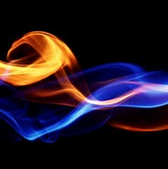
Forms of Kinetic energy
Thermal energy: all objects have thermal energy that increases as its temperature increase.
For example: Absorbing the sunlight or other chemical reactions causing heat.

Slide 13
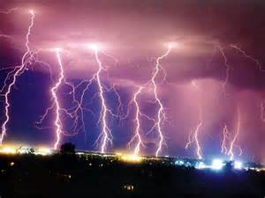
Forms of Kinetic energy
Radiant energy: energy carried by light.
For example an object that absorbs light may become warmer. The object absorbs energy from the light and this energy is transformed into thermal energy(heat).

Slide 14
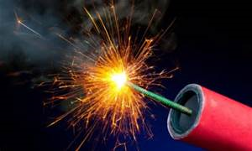
Forms of Potential energy
Chemical energy: energy that is stored in chemical bonds.
For example: The flame on a candle is a result of chemical energy stored in the wax/wick.
Battery

Slide 15
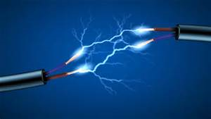
Forms of energy
Electrical energy: is energy that is carried by electrical current.
An electric device uses the electrical current flowing through in the device for power(energy!)
20 percent of the electrical energy used in the United Stated is generated by nuclear power plant

Slide 16
Forms of Potential Energy
Nuclear Energy: Every atomic nucleus contains energy that is called nuclear energy. This energy can also be transformed to other forms of energy.
Releasing nuclear energy is difficult! Not like lighting a match! We mist build complex power plants like this:

Slide 17
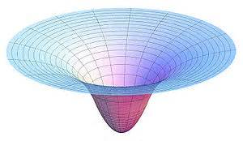
Forms of Potential energy
Gravitational energy: all objects that have an ability to be pulled by a gravitational force have gravitational potential energy
Egg Drop!!

Slide 18
Elastic potential energy
Ability to be stretched and revert back to normal shape
Tennis racket
Rubber band

Slide 19
Which of the potential energy types does not belong…(remember there are five types total)
Elastic
Gravitational
Physical
Chemical
Nuclear
Electrical
Mechanical

Slide 20
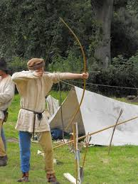
Identify the following picture as one of the 5 potential energy types.
Gravitational
Elastic
Electrical
Nuclear
Chemical

Slide 21
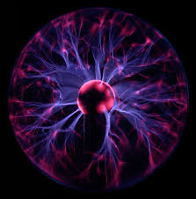
Identify the following picture as one of the 5 potential energy types.
Gravitational
Elastic
Electrical
Nuclear
Chemical

Slide 22
Identify the following picture as one of the 5 potential energy types.
Gravitational
Elastic
Electrical
Nuclear
Chemical

Slide 23
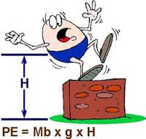
Identify the following picture as one of the 5 potential energy types.
Gravitational
Elastic
Electrical
Nuclear
Chemical

Slide 24
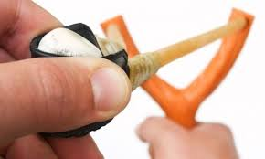
Identify the following picture as one of the 5 potential energy types.
Gravitational
Elastic
Electrical
Nuclear
Chemical

Slide 25
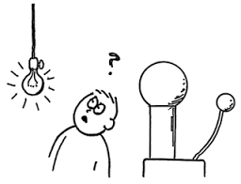
Identify the following picture as one of the 5 potential energy types.
Gravitational
Elastic
Electrical
Nuclear
Chemical

Slide 26
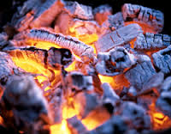
Identify the following picture as one of the 5 potential energy types.
Gravitational
Elastic
Electrical
Nuclear
Chemical

Slide 27
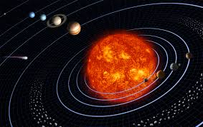
Identify the following picture as one of the 5 potential energy types.
Gravitational
Elastic
Electrical
Nuclear
Chemical

Slide 28
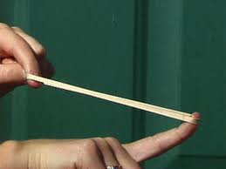
Identify the following picture as one of the 5 potential energy types.
Gravitational
Elastic
Electrical
Nuclear
Chemical

Slide 29
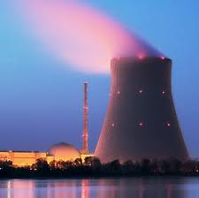
Identify the following picture as one of the 5 potential energy types.
Gravitational
Elastic
Electrical
Nuclear
Chemical

Slide 30
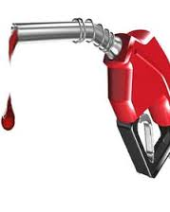
Identify the following picture as one of the 5 potential energy types.
Gravitational
Elastic
Electrical
Nuclear
Chemical

Slide 31
Roller coaster Lab!!!

Slide 32
Use the following roller coaster to label the highest potential point and the lowest potential point

Slide 33
Use the following roller coaster to label the highest potential point and the lowest potential point

Slide 34
Use the following roller coaster to label the highest kinetic point

Slide 35
Use the following roller coaster to label the highest kinetic point

Slide 36
Use the following roller coaster to label the highest kinetic point

Slide 37
Forms of Potential energy
Elastic Energy : The potential to stretch and reshape
Crossbow
Rubber band
Tennis racket

Slide 38
Questions

Slide 39
As you come in…
Describe the following on a fresh piece of paper:
Energy
Kinetic energy
Potential Energy
Thermal
Chemical
Radiant
Electrical
Nuclear

Slide 40
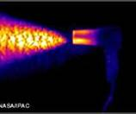
Energy Transformations
Energy is transforming continually between one form to another all around you!!!
Let think of some examples…
(Energy Transformations Web)

Slide 41
Energy Transformations
Law of Conservation on Energy: energy is never created or destroyed… just transformed into another form!!

Slide 42
Kinetic and Potential Energy

Slide 43
Energy Transformations
Radio Demonstration:

Slide 44
Energy Transformations
Generator: transforms kinetic energy into to Electrical energy!
Example: Flashlight

Slide 45
Energy Transformations
What types of energy are transformed when we eat and then play or exercise?

Slide 46
Challenge
Give one example of a process where energy transforms from one type to the next. The more CORRECT transfers you include the more likely it is that you win this challenge!!

Slide 47
Roller coasters!!
Lets practice these concepts by making a roller coaster
Rules and points

Slide 48
Sources of Energy
What does it mean to be a renewable or nonrenewable resource?
Do you know the different renewable and nonrenewable resources?

Slide 49
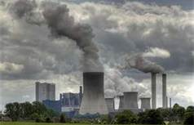
Nonrenewable
Fossil Fuels: Coal, oil, and natural gas made naturally by heat and pressure a long long time ago.
It takes millions of years to replace each drop of gasoline and each lump of coal we use!
Pollution, pollution, pollution!!!

Slide 50
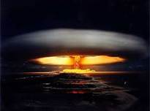
Nonrenewable
Nuclear Energy: unstable nucleuses broken apart to make a HUGE amount of energy compared to fossil fuels.
Much less pollution but it makes a Radioactive waste!!!

Slide 51
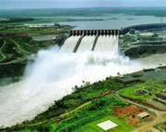
Renewable Resources
Hydroelectricity:
transforming potential energy of standing water and using it kinetically to create energy.
Largest renewable resource and is replenished continuously!
Pollution free BUT disrupts the life cycle of aquatic animals and fish! This has caused a huge decrease in salmon and other fish populations ☹

Slide 52
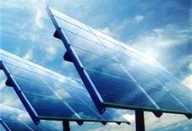
Renewable Resources
Solar Energy: energy formed from the suns light(radiant energy).
Solar energy is also considered an inexhaustible resource; it can never be used up!

Slide 53
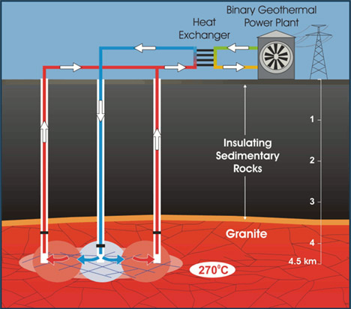
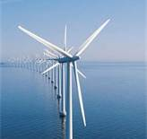
Other Alternative resources…
Geothermal
Wind

Slide 54
LAB page 738-739
Energy to power your life
Done as a class

Slide 55
http://www.pbslearningmedia.org/asset/phy03_vid_energysource/?utm_source=teachersdomain_redirect/asset/phy03_vid_energysource/utm_medium=teachersdomain/asset/phy03_vid_energysource/utm_campaign=td_redirects adult like reinforcement video about resources

Slide 56
Stations
1-5 Premade ☺

